Slide 1
Rajalakshmi Engineering College
An Autonomous Institution
Chennai-602105

Slide 2

PRINCIPLES OF ARTIFICIAL INTELLIGENCE (AI19341)

Slide 3

SYLLABUS
UNIT-I Introduction to Artificial intelligence and Problem- Solving Agent 9
Problems of AI, AI technique, Tic – Tac – Toe problem. Intelligent Agents, Agents & environment, nature of environment, structure of agents, goal-based agents, utility-based agents, learning agents. Defining the problem as state space search, production system, problem characteristics, issues in the design of search programs.
UNIT-II Search techniques 9
Problem solving agents, searching for solutions; uniform search strategies: breadth first search, depth first search, depth limited search, bidirectional search, comparing uniform search strategies. Heuristic search strategies Greedy best-first search, A* search, AO* search, memory bounded heuristic search: local search algorithms & optimization problems: Hill climbing search, simulated annealing search, local beam search.
UNIT-III Constraint satisfaction problems and Game Theory 9
Local search for constraint satisfaction problems. Adversarial search, Games, optimal decisions & strategies in games, the minimax search procedure, alpha-beta pruning, additional refinements, iterative deepening.
UNIT-IV Knowledge & reasoning 9
Statistical Reasoning: Probability and Bays’ Theorem, Certainty Factors and Rule-Base Systems, Bayesian Networks, Dempster-Shafer Theory, Fuzzy Logic. AI for knowledge representation, rule-based knowledge representation, procedural and declarative knowledge, Logic programming, Forward and backward reasoning.
UNIT-V Introduction to Machine Learning 9
Exploring sub-discipline of AI: Machine Learning, Supervised learning, Unsupervised learning, Reinforcement learning, Classification problems, Regression problems, Clustering problems, Introduction to neural networks and deep learning.

Slide 4
LAB SYLLABUS
1. Programs on Problem Solving
a. Write a program to solve 8 Queens problem
b. Solve any problem using a depth-first search
c. Implement MINIMAX algorithm
d. Implement A* algorithm
2 Programs on Decision Making and Knowledge Representation
a. Introduction to PROLOG
b. Implementation of Unification and Resolution Algorithm
c. Implementation of Backward Chaining
d. Implementation of forwarding Chaining
3 Programs on Planning and Learning
a. Implementation of Blocks World program
b. Implementing a fuzzy inference system
c. Implementing Artificial Neural Networks for an application using python
d. Implementation of Decision Tree
e. Implementation of the K-mean algorithm

Slide 5
BOOKS
TEXT BOOKS:
1. S. Russell and P. Norvig, Artificial Intelligence: A Modern Approach, Prentice Hall, Third Edition,2009.
2. Nils J. Nilsson, Artificial Intelligence: A New Synthesis (1 ed.), Morgan-Kaufmann, 1998. ISBN 978-1558605350.
REFERENCE BOOKS:
Elaine Rich, Kevin Knight, & Shivashankar B Nair, Artificial Intelligence, McGraw Hill, 3rd ed.,2017.
Introduction to Artificial Intelligence & Expert Systems, Patterson, Pearson, 1st ed. 2015
Logic & Prolog Programming, Saroj Kaushik, New Age International, Ist edition, 2002.
Expert Systems: Principles and Programming,11 March 1998. Edition: 4th. ISBN: 9788131501672

Slide 6
UNIT I Introduction to Artificial intelligence and Problem-Solving Agent
Problems of AI, AI technique, Tic – Tac – Toe problem. Intelligent Agents, Agents & environment, nature of environment, structure of agents, goal-based agents, utility-based agents, learning agents. Defining the problem as state space search, production system, problem characteristics, issues in the design of search programs.

Slide 7
UNIT I Introduction to Artificial intelligence and Problem-Solving Agent
What is AI ?
Artificial Intelligence is concerned with the design of intelligence in an artificial device.
The term was coined by McCarthy in 1956.
There are two ideas in the definition.
1. Intelligence 2. Artificial device
What is intelligence?
Intelligence is the computational part of the ability to achieve goals in the world.
It is the capacity to acquire and apply knowledge.
An inherent power of thought and reason.
In education ,the ability to learn or understand or to deal with new challenging situations.
What is artificial device?
Made by human beings instead of nature.
So, AI is nothing but a machine with thoughts and reason.

Slide 8
What’s involved in Intelligence?
Ability to interact with the real world
- to perceive, understand, and act
e.g., speech recognition, understanding and synthesis
-image understanding
- ability to take actions, have an effect
Reasoning and Planning
- modeling the external world, given input
- solving new problems, planning, and making decisions
- ability to deal with unexpected problems, uncertainties
Learning and Adaptation
- we are continuously learning and adapting
e.g., a baby learning to categorize and recognize animals

Slide 9
AI definition(Cont.)
We can define AI in two aspects:
A system with intelligence is expected to behave as intelligently as a human
A system with intelligence is expected to behave in the best possible manner
What type of behaviour are we talking about?
Are we looking at the thought process or reasoning ability of the system?
Or are we only interested in the final manifestations of the system in terms of its actions?
Concept of Rationality
A system is rational if it does the “right thing” , given what it knows.

Slide 10
AI Definitions in four aspects
Thinking Humanly
“The exciting new effort to make computers think . . . machines with minds, in the full and literal sense.” (Haugeland, 1985). “[The automation of] activities that we associate with human thinking, activities such as decision-making, problem solving, learning . . .” (Bellman, 1978)
Acting Humanly
“The art of creating machines that perform functions that require intelligence when performed by people.” (Kurzweil, 1990). “The study of how to make computers do things at which, at the moment, people are better.” (Rich and Knight, 1991)
Thinking Rationally
“The study of mental faculties through the use of computational models.” (Charniak and McDermott, 1985) “The study of the computations that make it possible to perceive, reason, and act.” (Winston, 1992)
Acting Rationally
“Computational Intelligence is the study of the design of intelligent agents.” (Poole et al., 1998) “AI . . . is concerned with intelligent behavior in artifacts.” (Nilsson, 1998)

Slide 11
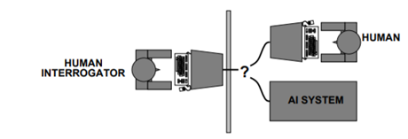
Acting humanly: The Turing Test approach
The Turing Test, proposed by Alan Turing (1950), was designed to provide a satisfactory operational definition of intelligence.
A computer passes the test if a human interrogator, after posing some written questions, cannot tell whether the written responses come from a person or from a computer.
The computer would need to possess the following capabilities:
natural language processing to enable it to communicate successfully in English;
knowledge representation to store what it knows or hears;
automated reasoning to use the stored information to answer questions and to draw
new conclusions;
machine learning to adapt to new circumstances and to detect and extrapolate patterns.

Slide 12
The Turing Test approach(Cont..)
Turing’s test avoided direct physical interaction between the interrogator and the computer,
The total Turing Test includes a video signal so that the interrogator can test the subject’s perceptual abilities.
To pass the total Turing Test, the computer will need
computer vision to perceive objects, and
robotics to manipulate objects and move about.
Predicted that by 2000, a machine might have a 30% chance of fooling a lay person for 5 minutes
Turing deserves credit for designing a test that remains relevant 60 years later.
Turing Test is not reproducible , constructive or amenable to mathematical analysis.

Slide 13
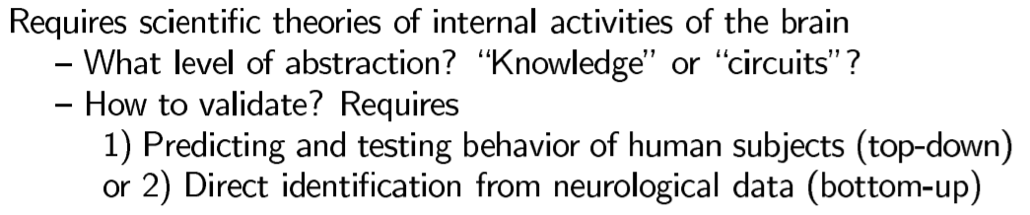
Thinking humanly: The cognitive modeling approach
If we are going to say that a given program thinks like a human, we must have some way of determining how humans think?
The interdisciplinary field of cognitive science brings together computer models from AI and experimental techniques from psychology to construct precise and testable theories of the human mind.

Slide 14
Thinking rationally: The “laws of thought” approach

Slide 15
Acting Rationally: The rational agent approach
An agent is just something that acts. Of course, all computer programs do something, but computer agents are expected to do more: operate autonomously, perceive their environment, persist over a prolonged time period, adapt to change, and create and pursue goals.
A rational agent is one that acts so as to achieve the best outcome or when there is uncertainty, the best-expected outcome.
The rational-agent approach has two advantages over the other approaches.
First, it is more general than the “laws of thought” approach because the correct inference is just one of several possible mechanisms for achieving rationality.
Second, it is more flexible to scientific development than are approaches based on human behavior or human thought.
Therefore, we will concentrate on general principles of rational agents and on components for constructing them.

Slide 16
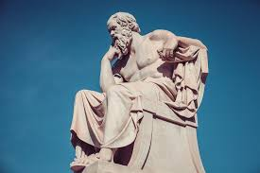
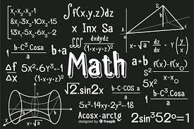
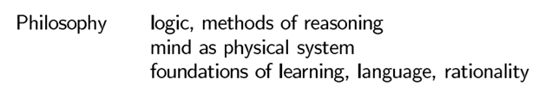

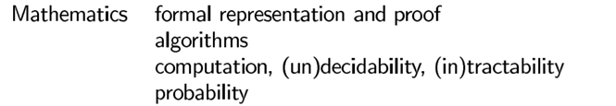
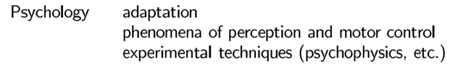
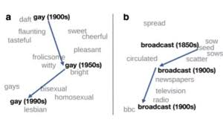
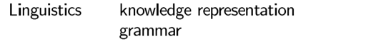

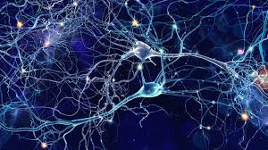
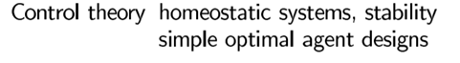
The Foundations of Artificial Intelligence

Slide 17
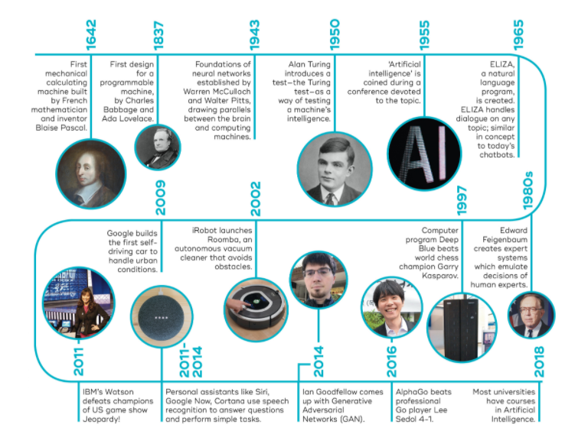
AI History

Slide 18
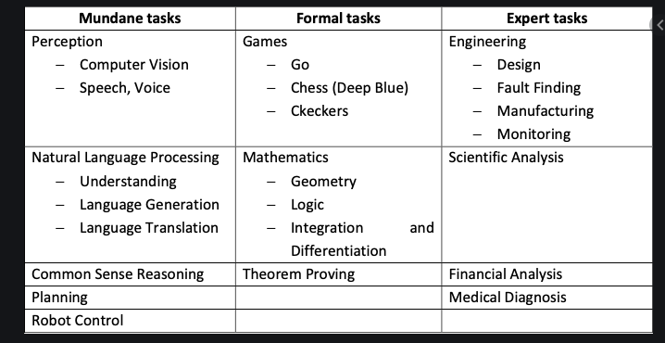
AI Tasks

Slide 19
Problems in AI
Artificial Intelligence research during the last three decades has concluded that Intelligence requires knowledge. To compensate for overwhelming quality, knowledge possesses less desirable properties.
It is huge.
It is difficult to characterize correctly.
It is constantly varying, continuous in nature
It differs from data by being organized in a way that corresponds to its application.
It is complicated

Slide 20
Problems in AI
To deal with the AI model we have to consider the following questions:
What are the underlying assumptions about intelligence?
What kinds of techniques will be useful for solving AI problems?
At what level human intelligence can be modeled?
When to realize an intelligent program has been built?

Slide 21
What is an AI technique?
It is a method that exploits knowledge that should be represented in such a way that:
The knowledge captures generalizations that share properties
It can be understood by people who must provide it—even though the bulk of the data for many programs comes automatically from readings.
It can easily be modified to correct errors and to reflect changes in the world
It can be used in many situations, even if it is not totally accurate or complete
It can be used to help overcome its sheer bulk by helping to narrow the range of possibilities that must usually be considered

Slide 22
AI Techniques
It is possible to solve AI problems without using AI techniques and also Non-AI-problems can be solved using AI –techniques.
AI techniques are problem-independent.

Slide 23
Tic-Tac-Toe Problem(1- approach)
The Tic-Tac-Toe game consists of a nine-element vector called BOARD; it represents the numbers 1 to 9 in three rows. An element contains the value 0 for blank, 1 for X, and 2 for O.
A MOVETABLE vector consists of 19,683 elements (3⁹) and is needed where each element is a nine-element vector. The contents of the vector are specially chosen to help the algorithm.
The algorithm makes moves by pursuing the following:
1. View the vector as a ternary number. Convert it to a decimal number.
2. Use the decimal number as an index in MOVETABLE and access the vector.
3. Set BOARD to this vector indicating how the board looks after the move.
This approach is capable in time but it has several disadvantages.
It takes more space and requires stunning effort to calculate the decimal numbers.
This method is specific to this game and cannot be completed.

Slide 24
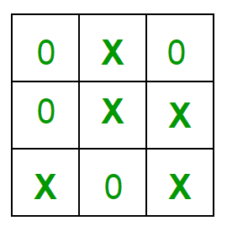
Tic-Tac-Toe Problem(1- approach)
Rules of the Game
The game is to be played between two people (in this program between HUMAN and COMPUTER).
One of the player chooses ‘O’ and the other ‘X’ to mark their respective cells.
The game starts with one of the players and the game ends when one of the players has one whole row/ column/ diagonal filled with his/her respective character (‘O’ or ‘X’).

Slide 25
Tic-Tac-Toe Problem(1- approach)
Implementation In our program the moves taken by the computer and the human are chosen randomly. We use rand() function for this. What more can be done in the program?
The program is in not played optimally by both sides because the moves are chosen randomly. The program can be easily modified so that both players play optimally (which will fall under the category of Artificial Intelligence).
Also the program can be modified such that the user himself gives the input (using scanf() or cin). The above changes are left as an exercise to the readers. Winning Strategy – An Interesting Fact If both the players play optimally then it is destined that you will never lose (“although the match can still be drawn”).
It doesn’t matter whether you play first or second.In another ways – “ Two expert players will always draw ”. Isn’t this interesting

Slide 26
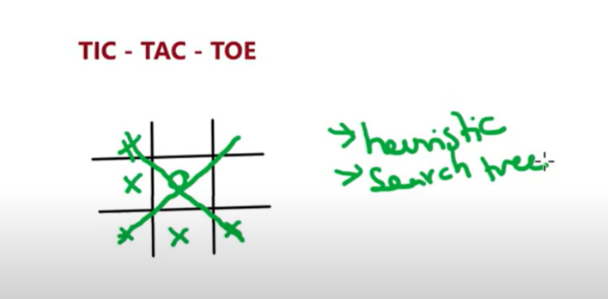
Tic-Tac-Toe Problem(1- approach)

Slide 27
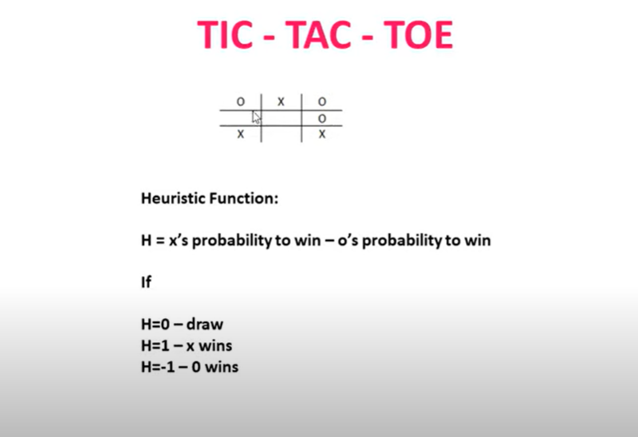
Tic-Tac-Toe Problem(1- approach)

Slide 28
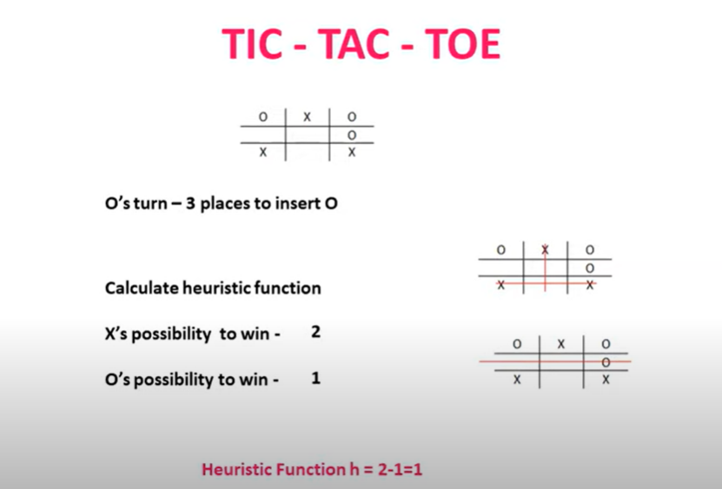
Tic-Tac-Toe Problem(1- approach)

Slide 29
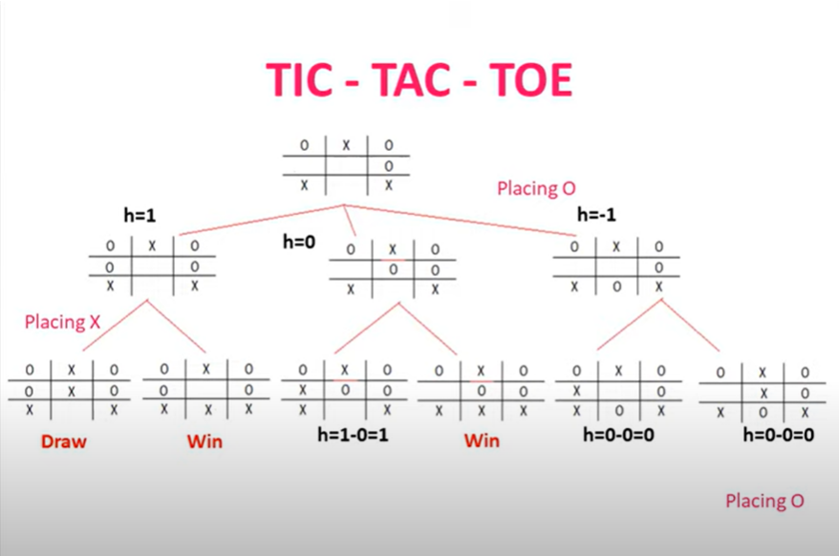
Tic-Tac-Toe Problem(1- approach)

Slide 30
Tic-Tac-Toe Problem(2-approach)
The structure of the data is as before but we use 2 for a blank, 3 for an X and 5 for an O. A variable called TURN indicates 1 for the first move and 9 for the last. The algorithm consists of three actions:
MAKE 2 - which returns 5 if the center square is blank Board[5]=2; otherwise it returns any blank non-corner square, i.e. 2, 4, 6 or 8.
POSSWIN (p) returns 0 if player p cannot win on the next move and otherwise returns the number of the square that gives a winning move . It checks each line using products 3*3*2 = 18 gives a win for X, 5*5*2=50 gives a win for O, and the winning move is the holder of the blank.
GO (n) makes a move to square n setting BOARD[n] to 3 or 5.
This algorithm is more involved and takes longer but it is more efficient in storage which compensates for its longer time. It depends on the programmer’s skill.

Slide 31
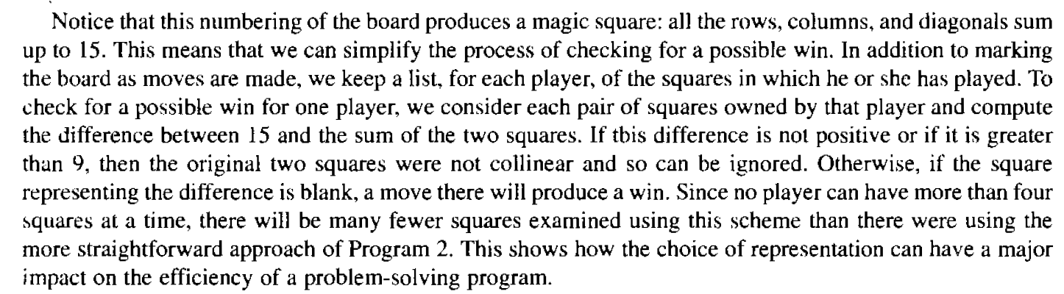
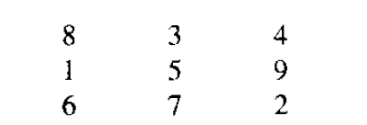
Tic-Tac-Toe Problem(2’- approach)

Slide 32
Tic-Tac-Toe Problem(3- approach)
The structure of the data consists of BOARD which contains a nine element vector, a list of board positions that could result from the next move and a number representing an estimation of how the board position leads to an ultimate win for the player to move.
This algorithm looks ahead to make a decision on the next move by deciding which the most promising move or the most suitable move at any stage would be and selects the same.
Consider all possible moves and replies that the program can make. Continue this process for as long as time permits until a winner emerges, and then choose the move that leads to the computer program winning, if possible in the shortest time.
Actually this is most difficult to program by a good limit but it is as far that the technique can be extended to in any game. This method makes relatively fewer loads on the programmer in terms of the game technique but the overall game strategy must be known to the adviser.

Slide 33
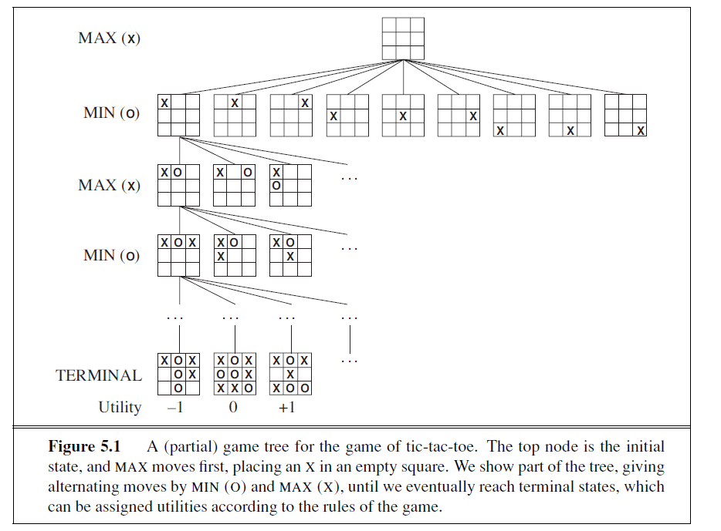

Slide 34
Agents and Environments
An agent is anything that can be viewed as perceiving its environment through sensors and acting upon that environment through actuators to achieve a predetermined goal.
We use the term percept to refer to the agent’s perceptual inputs at any given instant.
An agent’s percept sequence is the complete history of everything the agent has ever perceived.
Note: an agent’s choice of action at any given instant can depend on the entire percept sequence observed to date, but not on anything it hasn’t perceived.
An agent’s behavior is described by the agent function that maps any given percept sequence to an action

Slide 35
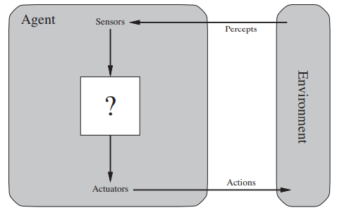
Agent

Slide 36
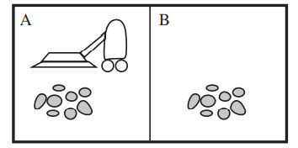
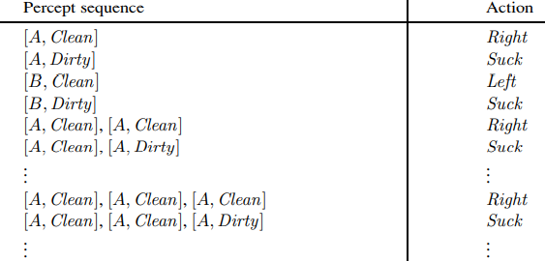
Agent Program
Internally, the agent function for an artificial agent will be implemented by an agent program.

Slide 37
Good Behaviour: The Concept Of Rationality
A rational agent is one that does the right thing.
This notion of desirability is captured by a performance measure that evaluates any given sequence of environment states.
Rationality: What is rational at any given time depends on four things:
The performance measure that defines the criterion of success.
The agent’s prior knowledge of the environment.
The actions that the agent can perform.
The agent’s percept sequence to date.

Slide 38
Rational Agent
Rational Agent: For each possible percept sequence, a rational agent should select an action that is expected to maximize its performance measure, given the evidence provided by the percept sequence and whatever built-in knowledge the agent has.

Slide 39
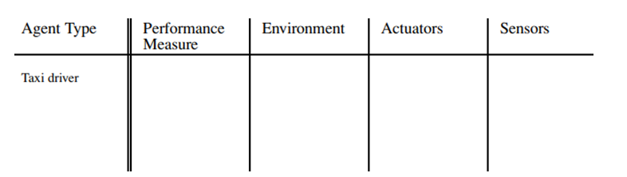
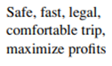
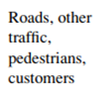
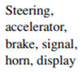
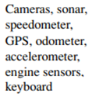
The Nature of Environments
The task environments, which are essentially the “problems” to which rational agents are the “solutions”.

Slide 40
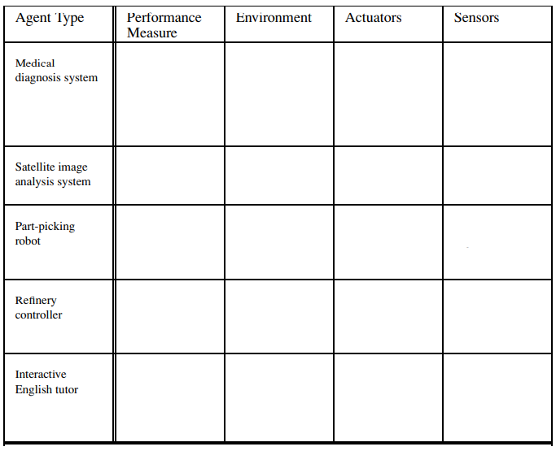
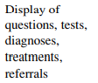
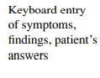
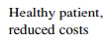
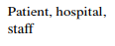
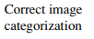
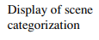
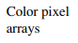
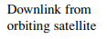
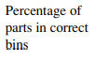
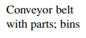
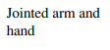
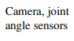
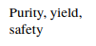
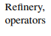
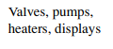
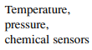
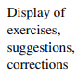
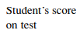
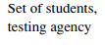
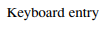

Slide 41
Properties of task environments
Fully observable vs. partially observable
If an agent’s sensors give it access to the complete state of the environment at each point in time, then we say that the task environment is fully observable.
An environment might be partially observable because of noisy and inaccurate sensors or because parts of the state are simply missing from the sensor data
Single agent vs. multiagent
crossword puzzle - Single agent
Chess- Two agents
Deterministic vs. stochastic
If the next state of the environment is completely deter mined by the current state and the action executed by the agent, then we say the environment is deterministic; otherwise, it is stochastic.

Slide 42
Properties of task environments
Episodic vs. sequential
In an episodic task environment, the agent’s experience is divided into atomic episodes. In each episode the agent receives a percept and then performs a single action. Crucially, the next episode does not depend on the actions taken in previous episodes.
In sequential environments, on the other hand, the current decision could affect all future decisions.
Chess and taxi driving are sequential: in both cases, short-term actions can have long-term consequences.
Episodic environments are much simpler than sequential environments because the agent does not need to think ahead.

Slide 43
Properties of task environments
Static vs. dynamic
If the environment can change while an agent is deliberating, then we say the environment is dynamic for that agent; otherwise, it is static.
Static environments are easy to deal with because the agent need not keep looking at the world while it is deciding on an action, nor need it worry about the passage of time.

Slide 44
Properties of task environments
Discrete vs. continuous
The discrete/continuous distinction applies to the state of the environment, to the way time is handled, and to the percepts and actions of the agent. For example, the chess environment has a finite number of distinct states (excluding the clock).Chess also has a discrete set of percepts and actions.
Taxi driving is a continuous-state and continuous-time problem: the speed and location of the taxi and of the other vehicles sweep through a range of continuous values and do so smoothly over time.

Slide 45




Task Environment Examples

Slide 46

The Structure of Agents
The job of AI is to design an agent program that implements the agent function— the mapping from percepts to actions.
This program will run on some sort of computing device with physical sensors and actuators—we call this the architecture

Slide 47

Agent Program
Notes:
Reference: Text book

Slide 48
Types of Agents
Simple reflex agents
Model-based reflex agents
Goal-based agents
Utility-based agents.

Slide 49


Simple reflex agent
The simplest kind of agent is the simple reflex agent.
These agents select actions based on the current percept, ignoring the rest of the percept history
if car-in-front-is-braking then initiate-braking
Rectangles are used to denote the current internal state of the agent’s decision process, and ovals represent the background information used in the process.

Slide 50

Simple reflex agent
INTERPRET-INPUT function generates an abstracted description of the current state from the percept.
RULE-MATCH function returns the first rule in the set of rules that matches the given state description.
The agent will work only if the correct decision can be made on the basis of only the current percept—that is, only if the environment is fully observable.
Even a little bit of unobservability can cause serious trouble
Infinite loops are often unavoidable for simple reflex agents operating in partially observable environments.

Slide 51

Model-based reflex agents
The agent should maintain some sort of internal state ,that depends on the percept history and thereby reflects at least some of the unobserved aspects of the current state.
This knowledge about “how the world works”—whether implemented in simple Boolean circuits or in complete scientific theories —is called a model of the world. An agent that uses such a model is called a model-based agent.

Slide 52

Model-based reflex agents(Cont.)
A model-based reflex agent. It keeps track of the current state of the world,
using an internal model. It then chooses an action in the same way as the reflex agent.

Slide 53

Goal-based agents
Knowing something about the current state of the environment is not always enough to decide what to do. For example, at a road junction, the taxi can turn left, turn right, or go straight on . The correct decision depends on where the taxi is trying to get to.
In other words, as well as a current state description, the GOAL agent needs some sort of goal information that describes situations that are desirable—for example, being at the passenger’s destination.
A model-based, goal-based agent. It keeps track of the world state as well as a set of goals it is trying to achieve, and chooses an action that will (eventually) lead to the achievement of its goals.

Slide 54
Goal-based agents(Cont..)
The agent program can combine this with the model to select actions that achieve the goal.
Search and planning are the subfields of AI devoted to finding action sequences that achieve the agent’s goals
A model-based, goal-based agent. It keeps track of the world state as well as a set of goals it is trying to achieve, and chooses an action that will (eventually) lead to the achievement of its goals.

Slide 55

Utility-based agents
Goals alone are not enough to generate high-quality behavior in most environments. For example, many action sequences will get the taxi to its destination (thereby achieving the goal) but some are quicker, safer, more reliable, or cheaper than others.
Goals just provide a crude binary distinction between “happy” and “unhappy” states.

Slide 56
Utility-based agents(cont..)
A more general performance measure should allow a comparison of different world states according to exactly how happy they would make the agent.
computer scientists use the term utility instead “ Happy” does not sound very scientific, economists and computer scientists use the term utility instead
The word “utility” here refers to “the quality of being useful.”
A rational utility-based agent chooses the action that maximizes the expected utility of the action outcomes

Slide 57

Learning agents
Learning element, which is responsible for making improvements
Performance element, which is responsible for selecting external actions.
Critic on how the agent is doing and ,determines how the performance element should be modified to do better in the future
Problem generator is responsible for suggesting actions that will lead to new and informative experiences.

Slide 58
PROBLEM FORMULATION
Problem formulation is the process of deciding what actions and states to consider, given a goal.
Formulate a Goal
Search
Problem Formulation
Execute

Slide 59
Components of a Problem
Five components need to define a problem as state space search problem –
Initial state– It is the starting point of an agent. i.e. in (Agent X). The starting state which agent knows itself.
Actions – A description of the possible actions available to the agent. Given a particular state s, ACTIONS(s) returns the set of actions that can be executed in s.
Transition model -A description of what each action does; the formal name for this is the transition model, specified by a function RESULT(s, a) that returns the state that results from doing action a in state s.
Successor Function -The set of possible actions available to the agent. The term operator is used to denote the description of an action in terms of which state will be reached by carrying out the action in a particular state.
For a successor function S, given a particular state x, S(x) returns the set of states reachable from x by any single action.
Set of all states reachable from initial state is known as state space search.
State Space – the state space forms a graph in which the nodes are states and arcs between nodes are actions.

Slide 60
Cont..
The goal test – In which the agent can apply to a single state description to determine if it is a goal state. Sometimes there is an explicit set of possible goal states, and the test simply checks to see if we have reached one of them. Sometimes the goal is specified by an abstract property rather than an explicitly enumerated set of states.
For example, in chess, the goal is to reach a state called "checkmate," where the opponent's king can be captured on the next move no matter what the opponent does.
Path cost– A path cost function is a function that assigns a cost to a path. In all cases we will consider , the cost of a path is the sum of the costs of the individual actions along the path. The path cost function is often denoted by g.
Path: A path in the state space is a sequence of states connected by a sequence of actions

Slide 61
Formal Description of the problem
Define a state space that contains all the possible configurations of the relevant objects.
Specify one or more states within that space that describe possible situations from which the problem solving process may start ( initial state)
Specify one or more states that would be acceptable as solutions to the problem. ( goal states)
Specify a set of rules that describe the actions (operations) available.

Slide 62


Problem Solving Agent

Slide 63
Problem Solving Agent-Approach
Goal Formulation-
Goal={world states which achieves desired results}
Goals help to organize behavior by limiting the objectives.
Problem Formulation-
After setting the goals ,it is the time to find out what will be the sequence of action which generate goal set.
It is the process of deciding what actions and states to consider , given a goal.
Searching-The agent’s search for desirable sequence of actions.
Execution- Once a solution is found , the actions it recommends can be carried out in the execution phase.

Slide 64


Toy problems - Vacuum world

Slide 65
Vacuum world problem

Slide 66

8-puzzle problem
The 8-puzzle problem consists of a 3 x 3 board with eight numbered tiles and a blank space.
A tile adjacent to the blank space can slide into the space.
The object is to reach a specified goal state.

Slide 67

8-puzzle problem …

Slide 68


8-QUEENS PROBLEM

Slide 69
The Water Jug Problem
You are given two jugs, a 4-gallon one and a 3-gallon one. Neither have any measuring markers on it. There is a pump that can be used to fill the jugs with water.
How can you get exactly 2 gallons of water into 4-gallon jug?
Let x and y be the amounts of water in 4-gallon and 3-gallon Gallon respectively
(x , y) refers to water available at any time in 4-gallon, 3-gallon jugs.
(x , y)→ (x - d, y + d) means drop some unknown amount d of water from 4-gallon and add d onto 3-gallon jug.
The state space for this problem can be described as the set of ordered pairs of integers (x , y) such that
x = 0, 1,2, 3 or 4 and y = 0,1,2 or 3; x represents the quantity of water in the 4-gallon jug and y represents the quantity of water in 3-gallon jug.
The start state is (0,0)
The goal state is (2,n)

Slide 70
Sl No | Current state | Next State | Description
1 | (x,y) if x < 4 | (4,y) | Fill the 4 gallon jug
2 | (x,y) if y <3 | (x,3) | Fill the 3 gallon jug
3 | (x,y) if x > 0 | (x-d, y) | Pour some water out of the 4 gallon jug
4 | (x,y) if y > 0 | (x, y-d) | Pour some water out of the 3-gallon jug
5 | (x,y) if x>0 | (0, y) | Empty the 4 gallon jug
6 | (x,y) if y >0 | (x,0) | Empty the 3 gallon jug on the ground
7 | (x,y) if x+y >= 4 and y >0 | (4, y-(4-x)) | Pour water from the 3 –gallon jug into the 4 –gallon jug until the 4-gallon jug is full
8 | (x, y) if x+y >= 3 and x>0 | (x-(3-y), 3) | Pour water from the 4-gallon jug into the 3-gallon jug until the 3-gallon jug is full
9 | (x, y) if x+y <=4 and y>0 | (x+y, 0) | Pour all the water from the 3-gallon jug into the 4-gallon jug
10 | (x, y) if x+y <= 3 and x>0 | (0, x+y) | Pour all the water from the 4-gallon jug into the 3-gallon jug
11 | (0,2) | (2,0) | Pour the 2 gallons from 3-gallon jug into the 4-gallon jug
12 | (2,y) | (0,y) | Empty the 2 gallons in the 4-gallon jug on the ground

Slide 71
Solution of water-jug problem
Gallons in the 4-gallon jug | Gallons in the 3-gallon jug | Rule applied
0 | 0 | 2
0 | 3 | 9
3 | 0 | 2
3 | 3 | 7
4 | 2 | 5 or 12
0 | 2 | 9 0r 11
2 | 0

Slide 72
Another solution of water-jug problem
Gallons in the 4-gallon jug | Gallons in the 3-gallon jug | Rule applied
0 | 0 | 1
4 | 0 | 8
1 | 3 | 4
1 | 0 | 8
0 | 1 | 1
4 | 1 | 8
2 | 3

Slide 73
Production Systems
Production systems provide appropriate structures for performing and describing search processes.
A production system consists of:
A set of rules, each consisting of a left side that determines the applicability of the rule and a right side that describes the operation to be performed if that rule is applied.
One or more knowledge/databases that contain whatever information is appropriate for the particular task. Some parts of the database may be permanent, while other parts of it may pertain only to the solution of the current problem.
A control strategy that specifies the order in which the rules will be compared to the database and a way of resolving the conflicts that arise when several rules match at once.
A rule applier

Slide 74
To solve a problem:
We must first reduce it to one for which a precise statement can be given. This can be done by defining the problem’s state space (start and goal states) and a set of operators for moving that space.
The problem can then be solved by searching for a path through the space from an initial state to a goal state.
The process of solving the problem can usefully be modeled as a production system.

Slide 75
Control Strategies
Control strategy decides which rule to apply next during the process of searching for a solution to a problem.
Requirements for a good Control Strategy
It should cause motion - In water jug problem, if we apply a simple control strategy of starting each time from the top of rule list and choose the first applicable one, then we will never move towards solution.
It should explore the solution space in a systematic manner -If we choose another control strategy, say, choose a rule randomly from the applicable rules then definitely it causes motion and eventually will lead to a solution. But one may arrive to same state several times. This is because control strategy is not systematic.

Slide 76

Breadth First Search
Algorithm:
1. Create a variable called NODE-LIST and set it to initial state
2. Until a goal state is found, or NODE-LIST is empty do
Remove the first element from NODE-LIST and call it E. If NODE-LIST was empty, quit
For each way that each rule can match the state described in E do:
Apply the rule to generate a new state
If the new state is a goal state, quit and return this state
Otherwise, add the new state to the end of NODE-LIST
Advantages of BFS
BFS will not get trapped exploring a blind alley. This contrasts with DFS, which may follow a single unfruitful path for a very long time, perhaps forever, before the path terminates in a state that has no successors.
If there is a solution, BFS is guaranteed to find it.
If there are multiple solutions, then a minimal solution will be found.

Slide 77

Depth First Search
If the initial state is a goal state, quit and return success
Otherwise, do the following until success or failure is signaled:
Generate a successor, E, of initial state. If there are no more successors, signal failure.
Call Depth-First Search, with E as the initial state
If success is returned, signal success. Otherwise continue in this loop.
Advantages of Depth-First Search
DFS requires less memory since only the nodes on the current path are stored.
By chance, DFS may find a solution without examining much of the search space at all.

Slide 78

Problem Characteristics
In order to choose the most appropriate method(s) for a particular problem , we must analyze the problem along several dimensions.
1. Is the problem decomposable into a set of independent smaller sub problems?
Example: Decomposable Problem
Decomposable problems can be solved by the divide-and-conquer technique. In divide and conquer technique, divide the problem into sub-problems, find the solutions for the sub-problems. Finally, integrate the solutions for the sub-problems, we will get the solution for the original problem. Suppose we want to solve the problem of computing the integral of the following expression
∫(x2+ 3x + sin2x * cos2x) dx

Slide 79

Problem Characteristics
Example : Non-Decomposable problem There are non-decomposable problems. For example, Block world problem is non-decomposable.

Slide 80
Problem Characteristics
2. Can Solution Steps be ignored or at least undone if they prove to be unwise?
In real life, there are three important types of problems:
Ignorable ( theorem proving)
Recoverable ( 8-puzzle)
Irrecoverable ( Chess)
Ignorable ( theorem proving)
Suppose we have proved some lemma in order to prove a theorem and eventually realized that lemma is no help at all, then ignore it and prove another lemma.
It can be solved by using simple control strategy.
Recoverable ( 8-puzzle)
Objective of 8 puzzle game is to rearrange a given initial configuration of eight numbered tiles on 3 X 3 board (one place is empty) into a given final configuration (goal state). Rearrangement is done by sliding one of the tiles into empty square.

Slide 81
Problem Characteristics
2 | 8 | 3
1 | 6 | 4
7 |  | 5
1 | 2 | 3
4 | 5 | 6
7 | 8
2 | 8 | 3
1 |  | 4
7 | 6 | 5
2 | 8 | 3
1 | 4
7 | 6 | 5
2 | 8
1 | 4 | 3
7 | 6 | 5
2 |  | 8
1 | 4 | 3
7 | 6 | 5
Start state
Final state
 | 2 | 8
1 | 4 | 3
7 | 6 | 5
1 | 2 | 8
 | 4 | 3
7 | 6 | 5
1 | 2 | 8
4 |  | 3
7 | 6 | 5
1 | 2 | 8
4 | 6 | 3
7 |  | 5
1 | 2 | 8
4 | 6 | 3
7 | 5
1 | 2 | 8
4 | 6
7 | 5 | 3
1 | 2
4 | 6
7 | 5 | 3

Slide 82
Problem Characteristics
Irrecoverable ( Chess)
A stupid move cannot be undone.
Can be solved by planning process.
3. Is the universe predictable?
There are two types of problems. Certain outcome and uncertain outcome.
Certain outcome (8-puzzle problem)
Able to plan the entire sequence of moves.
Uncertain outcome (Bridge game)
It is not possible to plan the entire sequence of actions. We do not know exactly where all the cards are or what the other players will do on their turns. To overcome this, investigate several plans and use probabilities of the various outcomes to choose a plan that has the highest estimated probability of leading to a good score on the hand.

Slide 83
Problem Characteristics
4. Is a good solution absolute or relative?
There are two types of problems
Any path problem
Best path problem
Any path problem
Any path problems can often be solved in a reasonable amount of time by using heuristics that suggest good paths to explore.
Consider a problem of answering questions based on the database of simple facts.
1. Marcus was a man.
2. Marcus was a Pompeian.
3. Marcus was born in 40AD.
4. All men are mortal.
5. All Pompeian died in 79 AD.
6. No mortal lives longer than 150 years.
7. It is now 1991 AD.

Slide 84
Problem Characteristics
Suppose we ask a question ,”Is Marcus is alive?”. From the facts given we can easily derive an answer to the question.
1. Marcus was a man. 1
4. All men are mortal. 4
8. Marcus was a mortal. 1, 4
3. Marcus was born in 40AD. 3
7. It is now 1991 AD. 7
9. Marcus age is 1951 years. 3, 7
6. No mortal lives longer than 150 years. 6
10. Marcus was dead 6.8.9
OR
7. It is now 1991 AD. 7
5. All Pompeian died in 79 AD. 5
11. All Pompeian are dead now. 7, 5
2. Marcus was a Pompeian. 2
10. Marcus was dead 11, 2
Either of two reasoning paths will lead to the answer. We need to find only the answer to the question. No need to go back and see if some other path might also lead to a solution.

Slide 85


Problem Characteristics
Best path problem
In travelling salesman problem, our goal is to find the shortest route that visits each city exactly once.

Slide 86
Problem Characteristics
5. Is the solution a state or path?
State
Finding a consistent interpretation for the sentence “The bank president ate a dish of pasta salad with the fork”. We need to find the interpretation but not the record of the processing.
Path
In water jug problem, it is not sufficient to report that the problem is solved, and the goal is reached, it is (2,0). For this problem, we need the path from the initial state to the goal state.

Slide 87
Problem Characteristics
6. What is the role of knowledge?
For e.g., Chess playing
Knowledge about the legal moves of the problem is needed. Without the knowledge, we can not be able to solve the problem.
7. Does the task require Interaction with a person?
Solitary in which the computer is given a problem description and produces an answer with no intermediate communication and no demand for an explanation of the reasoning process.
Conversational in which there is intermediate communication between a person and the computer, either to provide additional assistance to the computer or to provide additional information to the user, or both.

Slide 88
Production System Characteristics
Production systems provide us with good ways of describing the operations that can be performed in a search for a solution to a problem.
At this time, two questions may arise:
1. Can production systems be described by a set of characteristics? And how can they be easily implemented?
2. What relationships are there between the problem types and the types of production systems well suited for solving the problems?

Slide 89
Production Characteristics
1. A monotonic production system is a production system in which the application of a rule never prevents the later application of another rule that could also have been applied at the time the first rule was selected.
2. A non-monotonic production system is one in which this is not true. These are useful to solve ignorable problems.
3. A partially commutative production system is a production system with the property that if the application of a particular sequence of rules transforms state P into state Q, then any combination /permutation of those rules that is allowable also transforms state P into state Q.
4. A commutative production system is a production system that is both monotonic and partially commutative.

Slide 90

Production Characteristics
Blocks world problem
8-puzzle problem

Slide 91
Production Characteristics
Partially commutative non-monotonic Production System
Example: Robot Navigation
The Robot has the following operators: go north (N), go east (E), go south (S), and go west (W). To reach its goal, it does not matter whether the robot executes N-N-E or N-E-N.
Non-partially commutative monotonic Production System
Example: Chemical synthesis
“Add chemical x to pot” OR “Change temperature to t degrees”
These operators may cause irreversible changes to the potion being brewed. The order in which they are performed can be very important in determining the final output.

Slide 92
Issues in the Design of Search Programs
Each search process can be considered to be a tree traversal.
The objective of the search is to find a path from the initial state to a goal state using a tree.
The number of nodes generated might be huge; and in practice many of the nodes would not be needed.
The secret of a good search routine is to generate only those nodes that are likely to be useful, rather than having a precise tree.
The rules are used to represent the tree implicitly and only to create nodes explicitly if they are actually to be of use

Slide 93
Issues in the Design of Search Programs
The tree can be searched forward from the initial node to the goal state or backwards from the goal state to the initial state.
To select applicable rules, it is critical to have an efficient procedure for matching rules against states.
How to represent each node of the search process?
This is the knowledge representation problem or the frame problem. In games, an array suffices; in other problems, more complex data structures are needed.

Slide 94



Issues in the Design of Search Programs

Slide 95
Check duplicate nodes

